Slide 1
CMW _ Final project _ GURPREET KAUR _633287506

Slide 2

First page

Slide 3
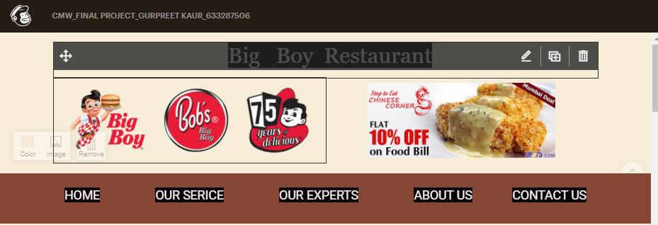
About big boy restaurant and services

Slide 4
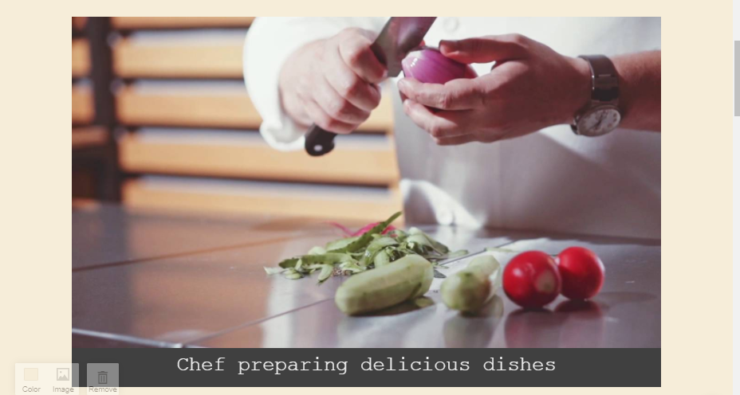
Short video chef preparing food in restaurant

Slide 5
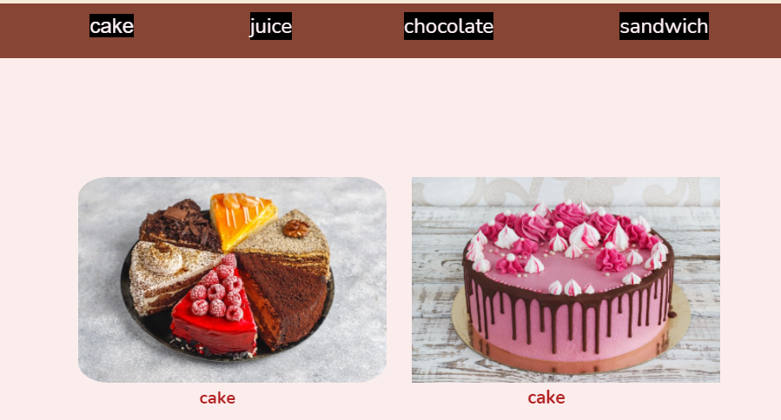
Special cakes

Slide 6
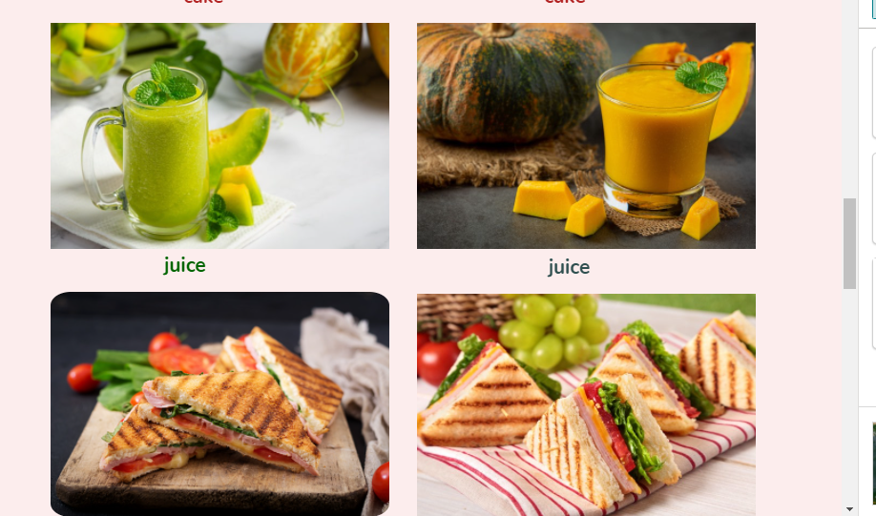
Juices and sandwichs

Slide 7
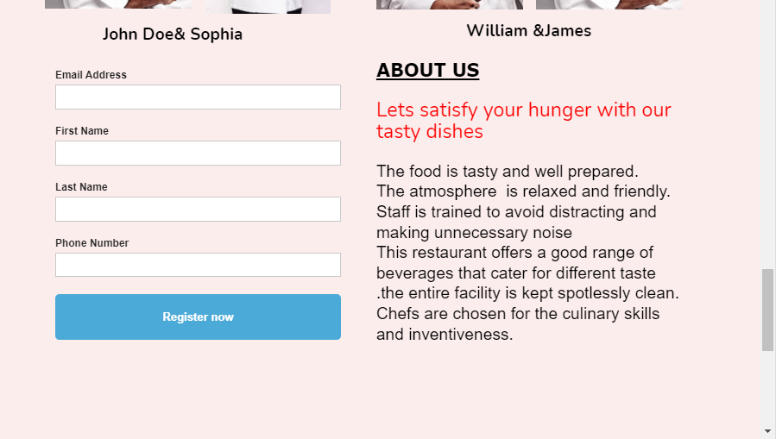
Contact us and about us

Slide 8
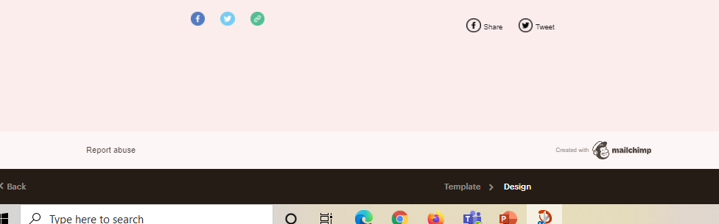
Footer

